Slide 1
NMRLipids Databank
Internal structure and functioning
Alexey M. Nesterenko
comcon1@pm.me
https://github.com/comcon1
NMRLipids2025, Bergen, Norway

Slide 2



Coding | Building | Using

Slide 3
Part II: Building

Slide 4
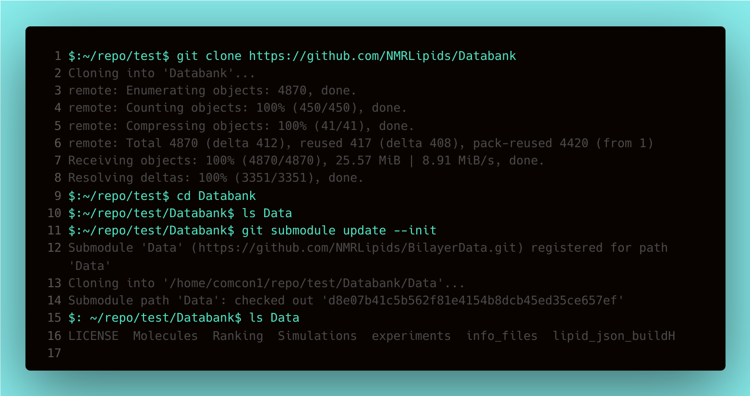
Deploying the Databank
Data is now under separated version control.

Slide 5
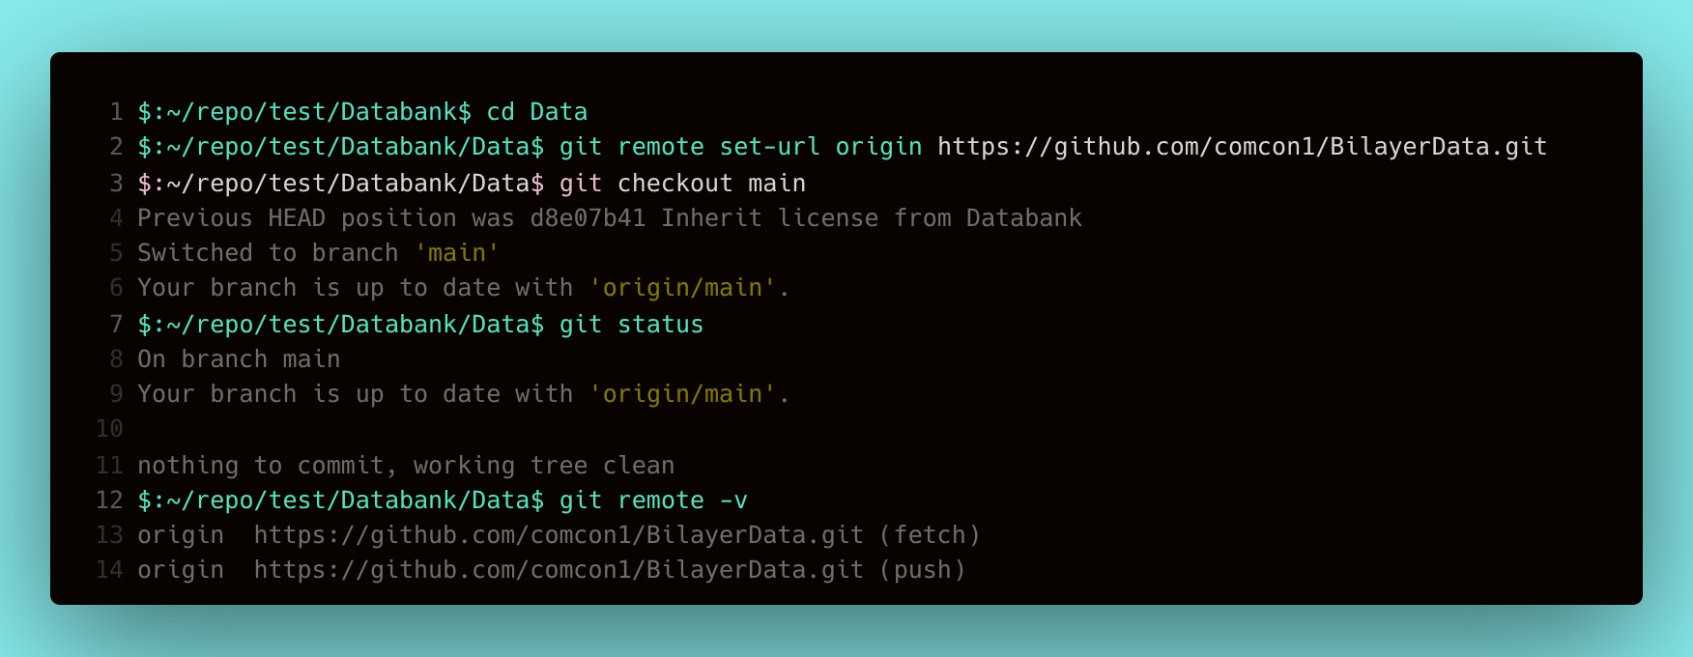
Switching to your Data-fork

Slide 6
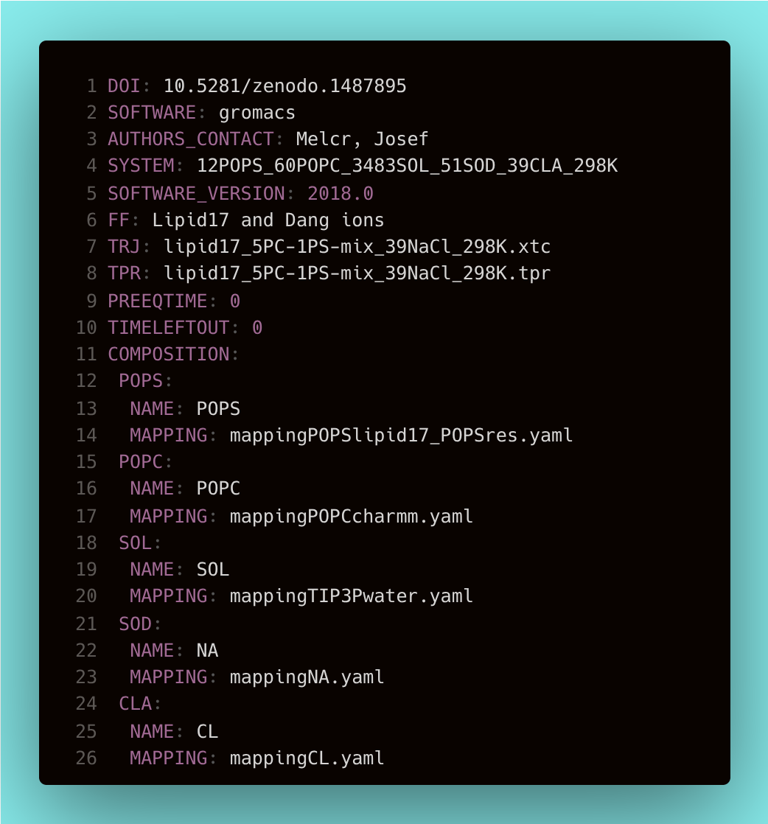
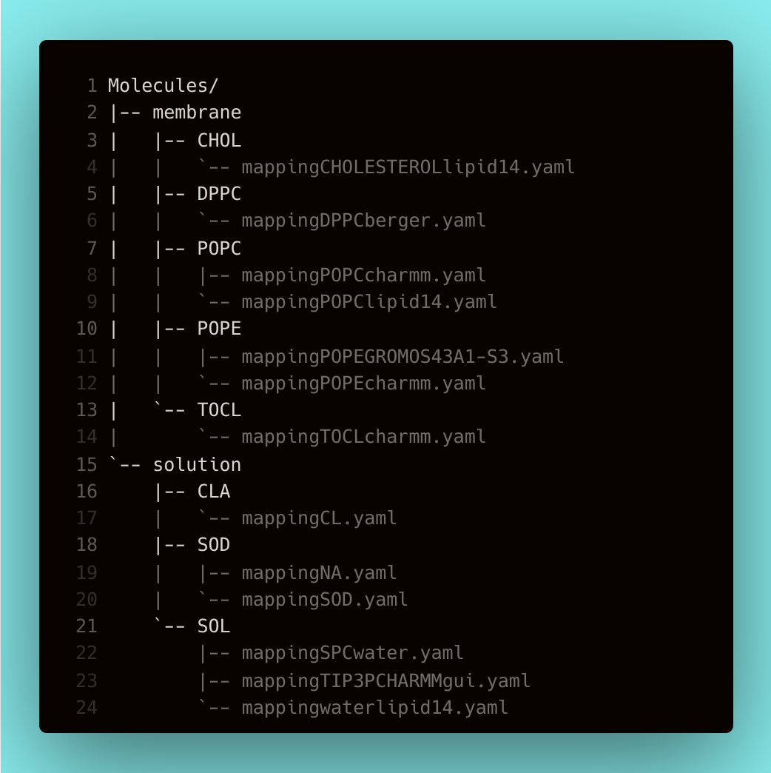
Adding a simulation with existing molecules
source.yaml
Mappings

Slide 7
Building script 1: AddData.py
source.yaml
Data/Molecules/*/*
External repo
Scripts/BuildDatabank/AddData.py
Data/Simulations/a8c/902/ a8c902af83267fc386b4222715cf64fffbb3468f/ fd8a26805af5559d5a75fd4965ae9ba24b831005/ README.yaml
Local copy

Slide 8
Analysis through DatabankLib.analyze library
Data/Simulations/a8c/902/ a8c902af83267fc386b4222715cf64fffbb3468f/ fd8a26805af5559d5a75fd4965ae9ba24b831005/ README.yaml
Local copy
DatabankLib.analyze.computeAPL
Data/Simulations/a8c/902/ a8c902af83267fc386b4222715cf64fffbb3468f/ fd8a26805af5559d5a75fd4965ae9ba24b831005/ apl.json
Computed property: area

Slide 9
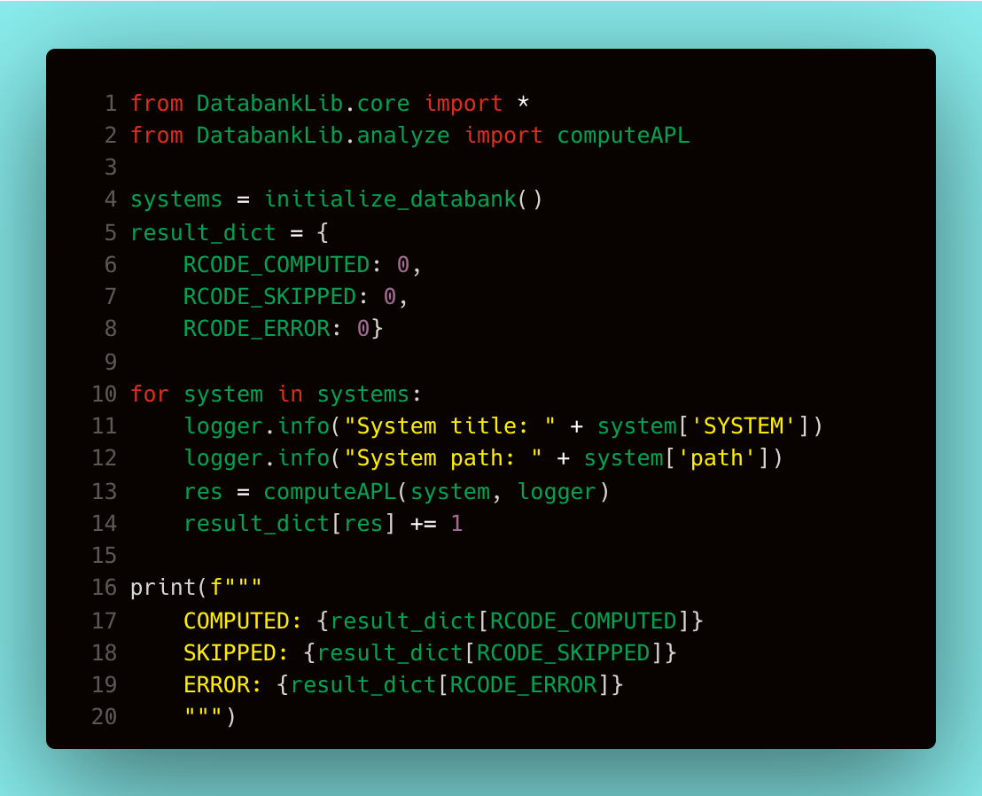
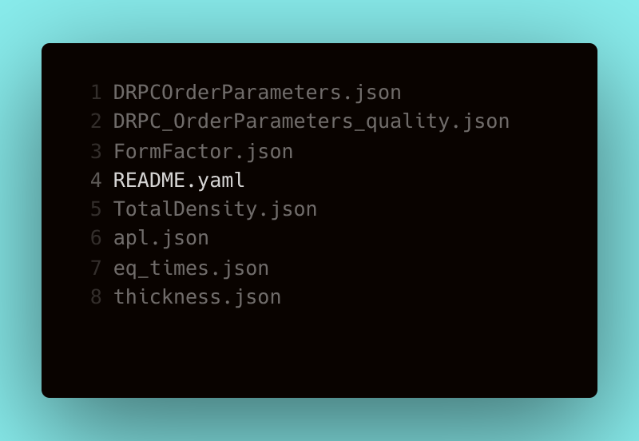
Building script 2: calcProperties.sh
+Computed properties

Slide 10
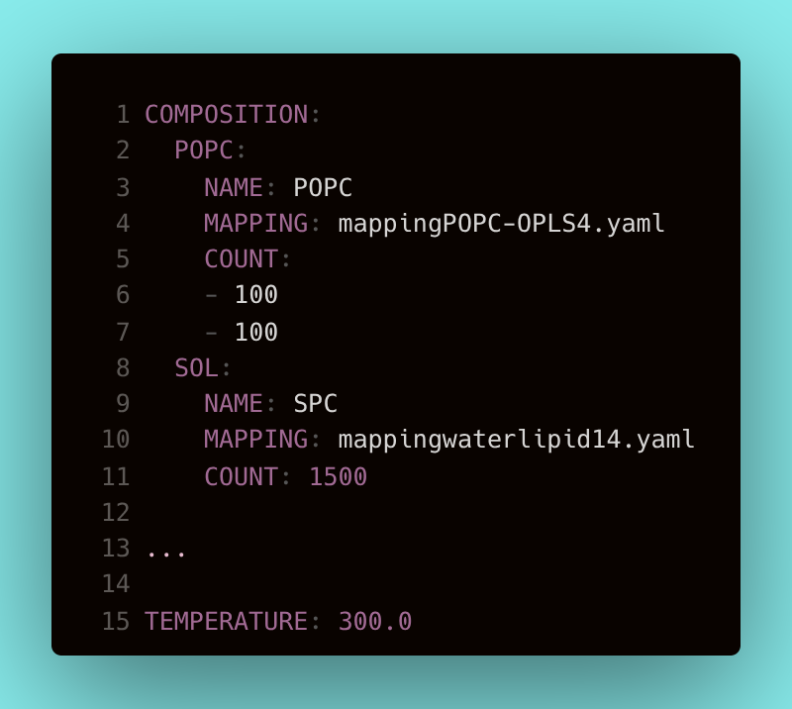
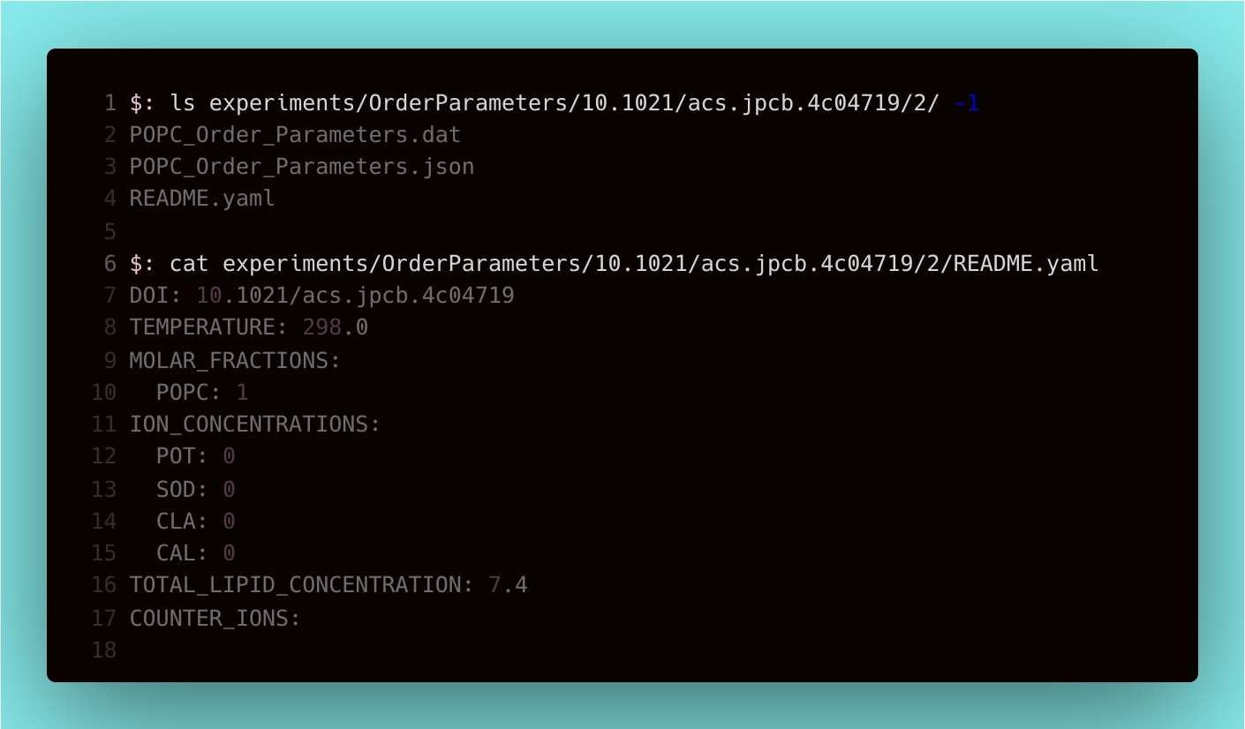
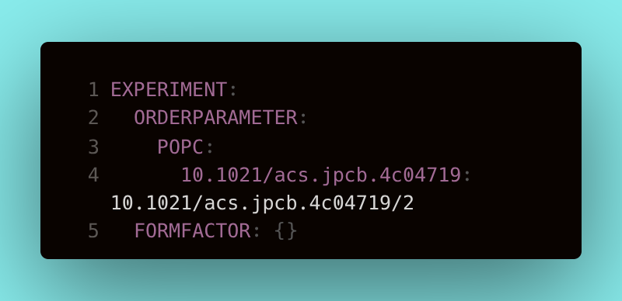
Building script 3: searchDATABANK.py
README.yaml
Experiment's
README.yaml
README.yaml
Scripts/BuildDatabank/searchDATABANK.py

Slide 11
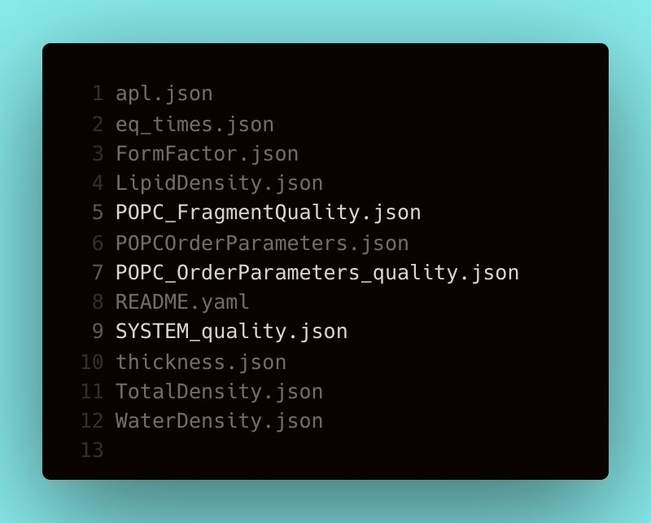
Building script 3: QualityEvaluation.py
Data/experiments/OrderParameters/ 10.1021/acs.jpcb.4c04719/2/ POPC_OrderParameter.json
Data/Simulations/a8c/902/ a8c902af83267fc386b4222715cf64fffbb3468f/ fd8a26805af5559d5a75fd4965ae9ba24b831005/ POPC_OrderParameter.json
Scripts/BuildDatabank/QualityEvaluation.py
+Quality

Slide 12
Simulation record is done!
Push to a branch in your fork
Data/Simulations/a8c/902/ a8c902af83267fc386b4222715cf64fffbb3468f/ fd8a26805af5559d5a75fd4965ae9ba24b831005/
Open pull-request
Pre-merge actions
Get reviewed
Rebase&merge
Post-merge actions
README + Computed prop-s + Quality

Slide 13
Part III: Usage

Slide 14
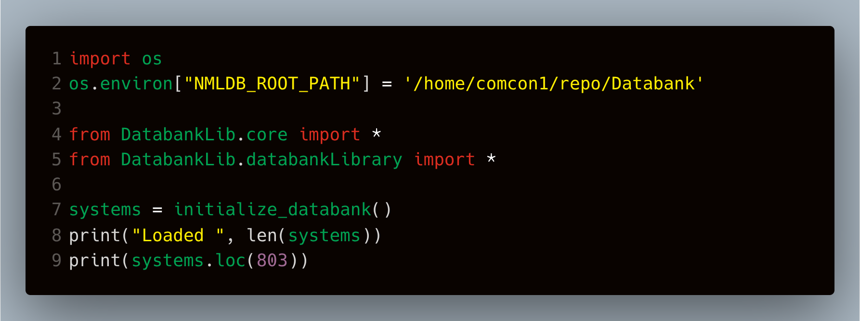
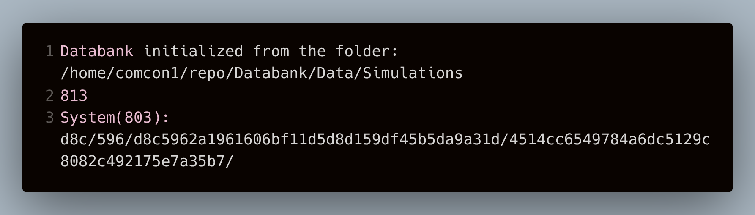
Getting started
Path to the data storage is set before module initialization
Construction simulation array
Hash-path allows to locate the system in `Data/Simulations` folder

Slide 15
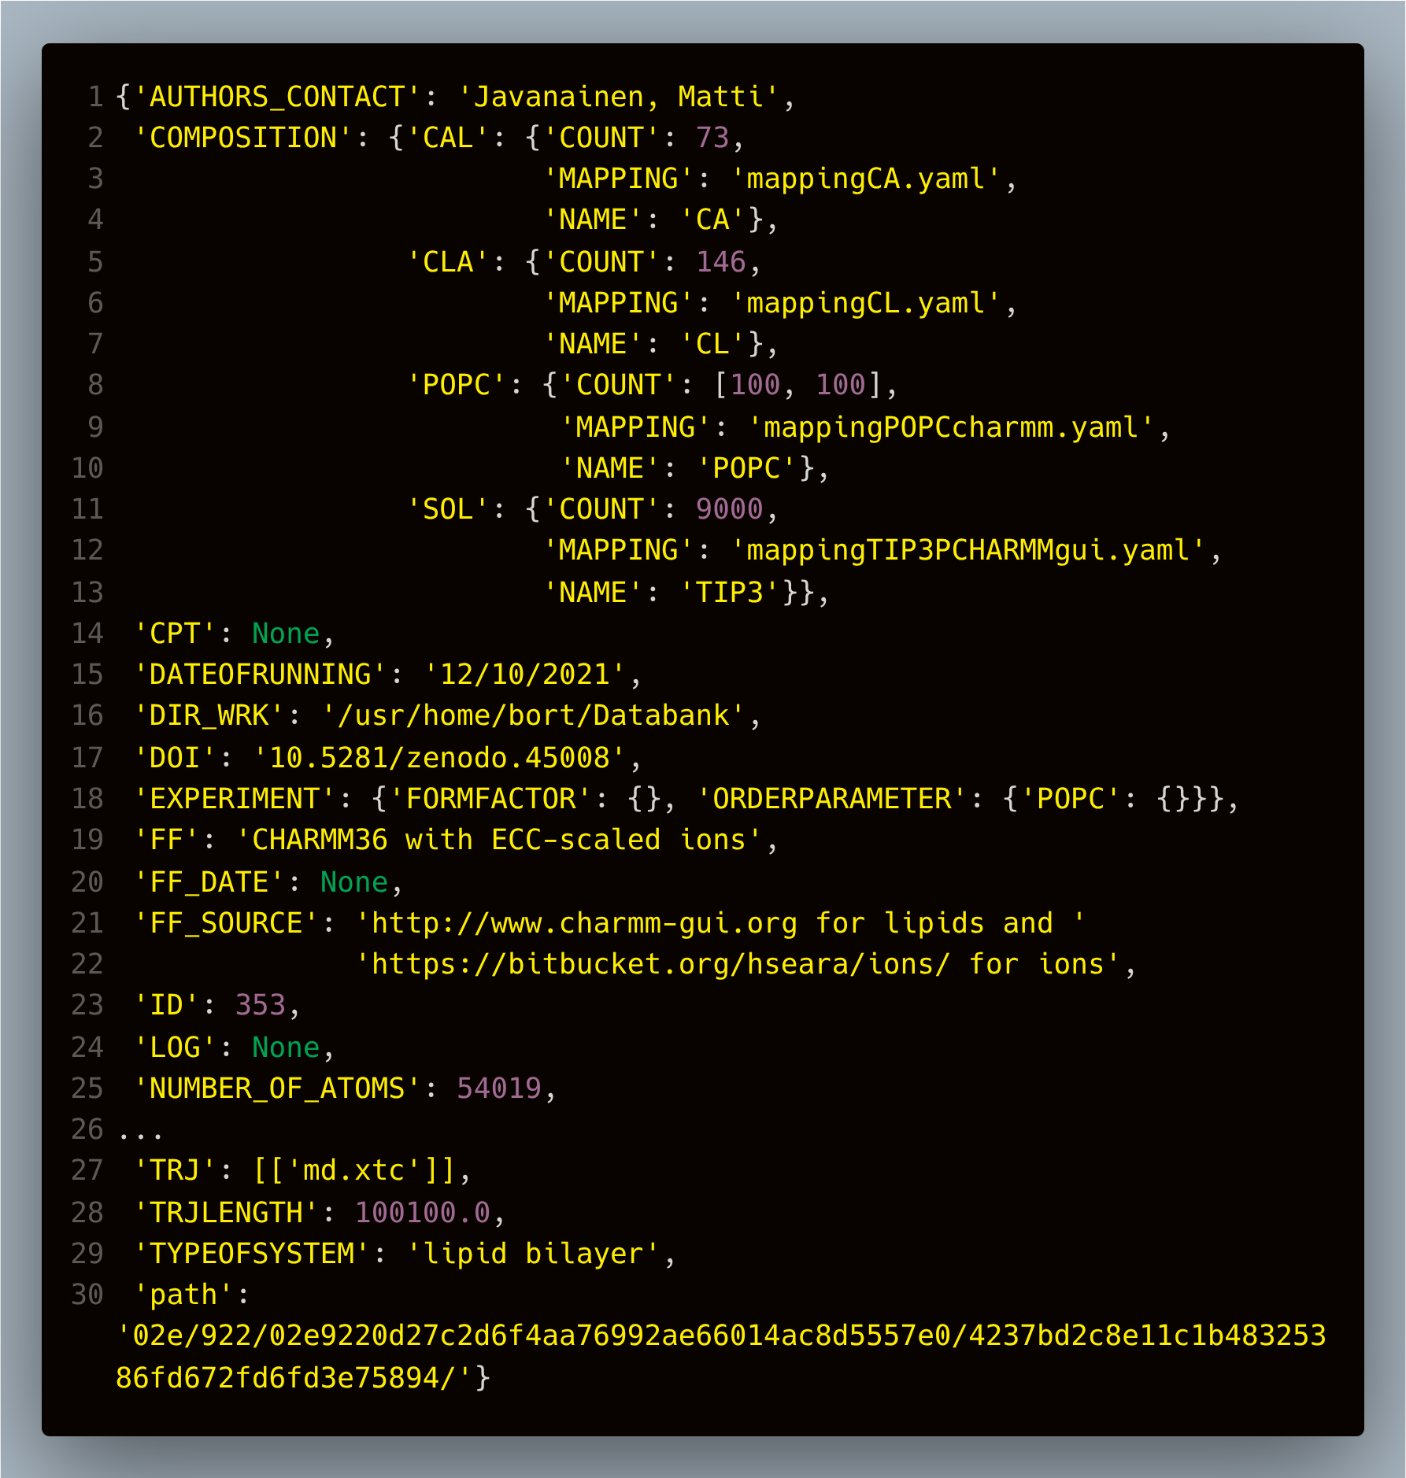
System entity: access to README.yaml
Description of REAMDE.yaml standard:
https://nmrlipids.github.io/READMEcontent.html
Composition information
Link to trajectory storage
https://www.databank.nmrlipids.fi/trajectories/353
Path to the folder

Slide 16
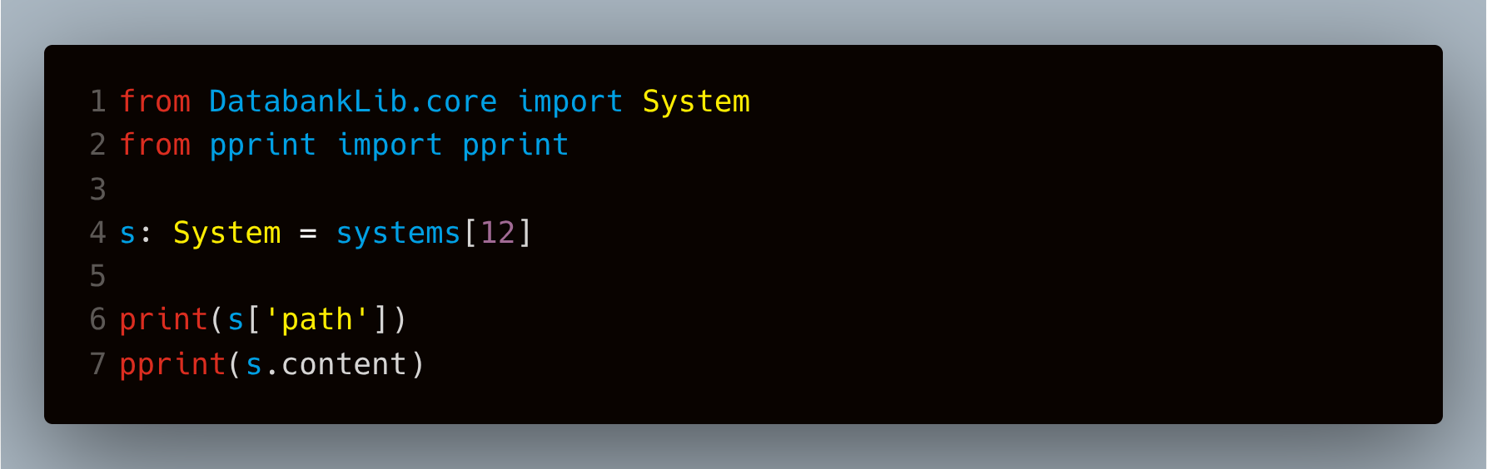
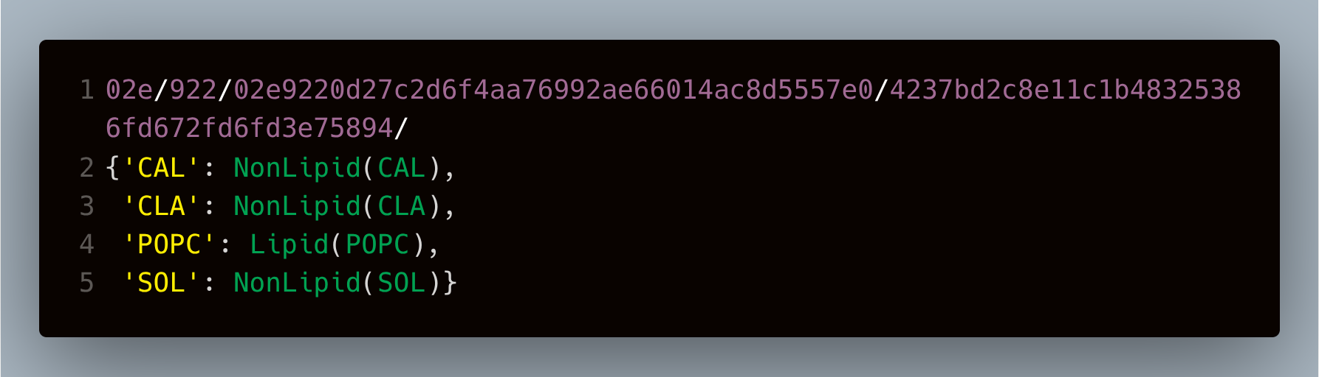
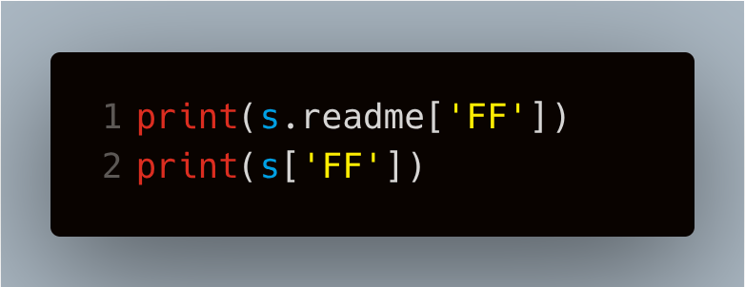
System is more than a dictionary
content property gives access to information about molecules
Mirroring interfaces:

Slide 17
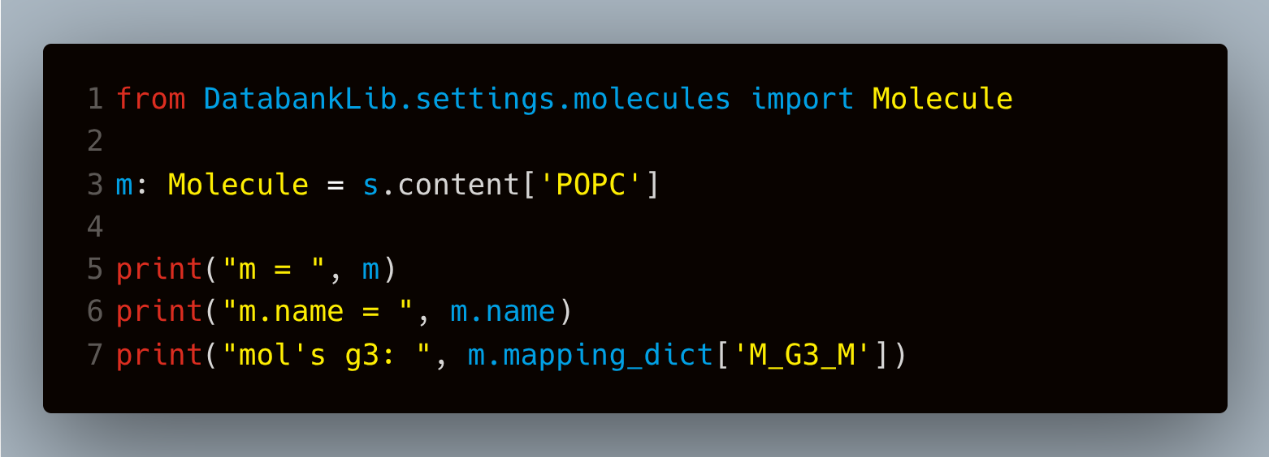
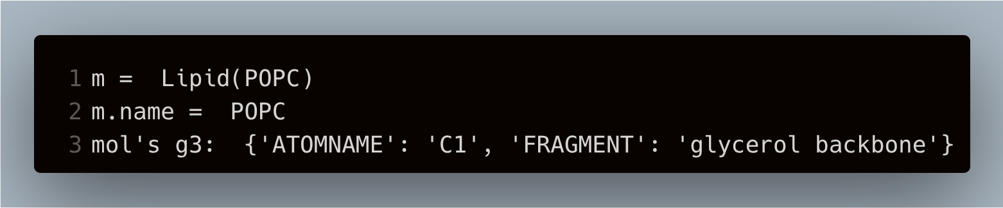
Molecule handling in DatabankLib
Molecule
mapping_dict
Lipid
NonLipid
metadata
Access to mapping information through System.content property

Slide 18
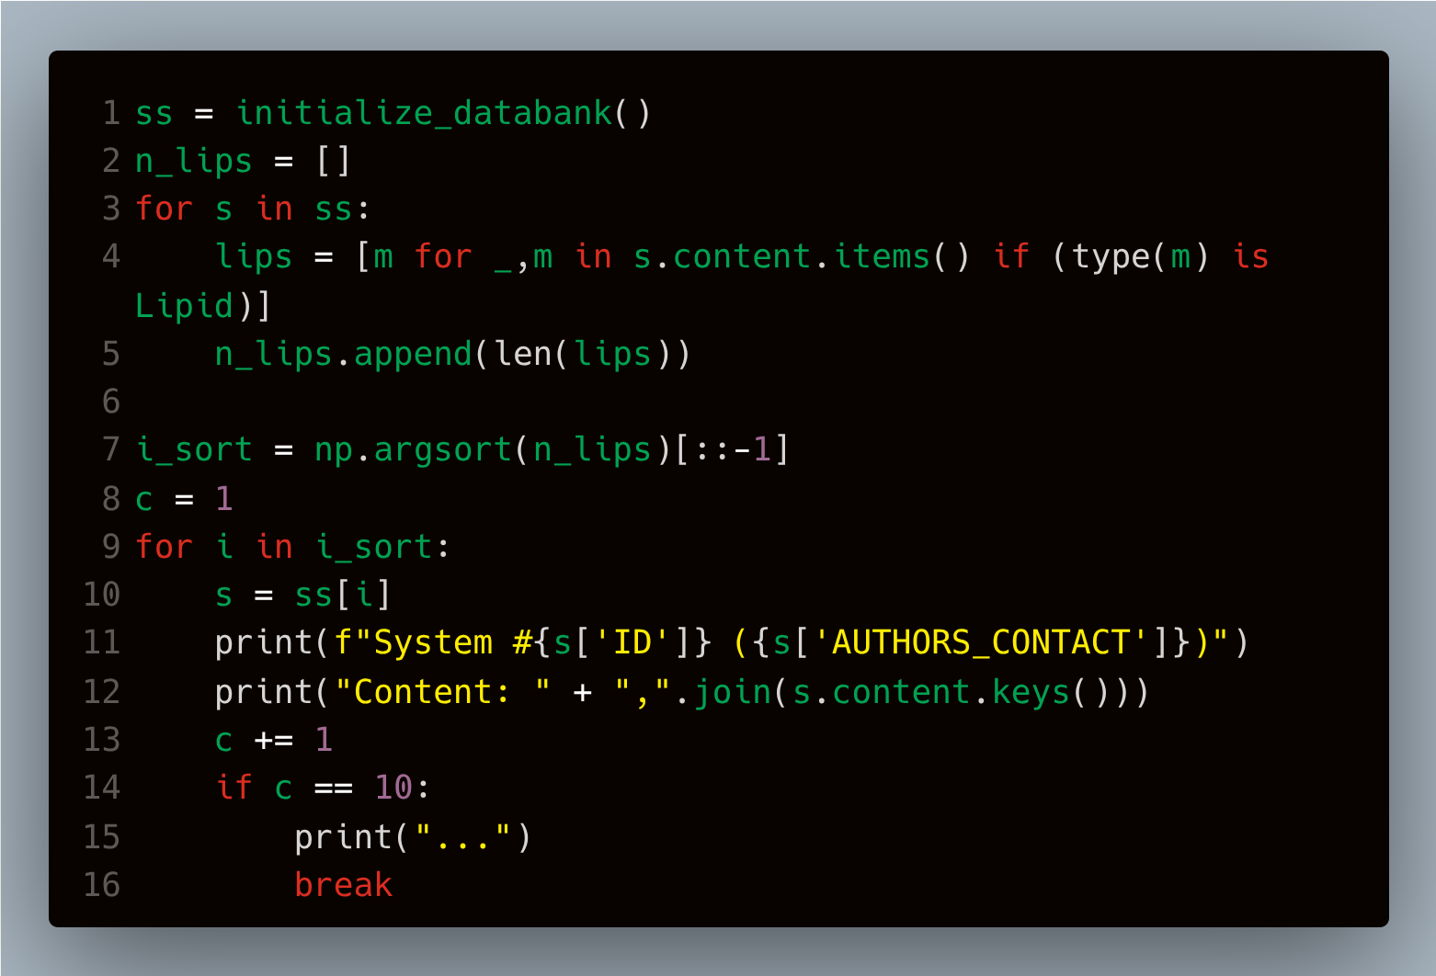
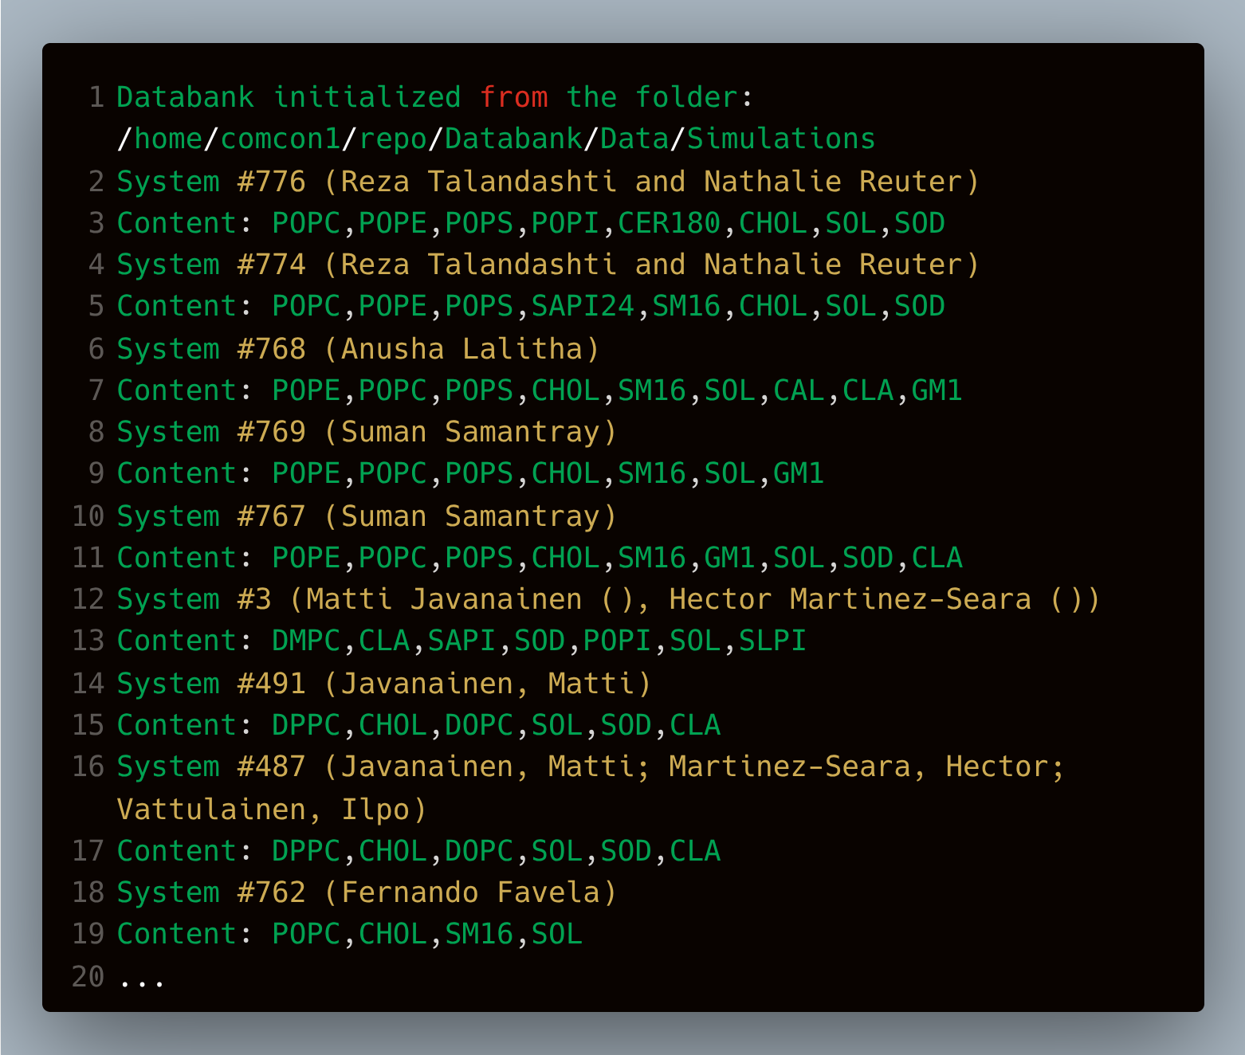
Example using DatabankLib library to access the databank

Slide 19
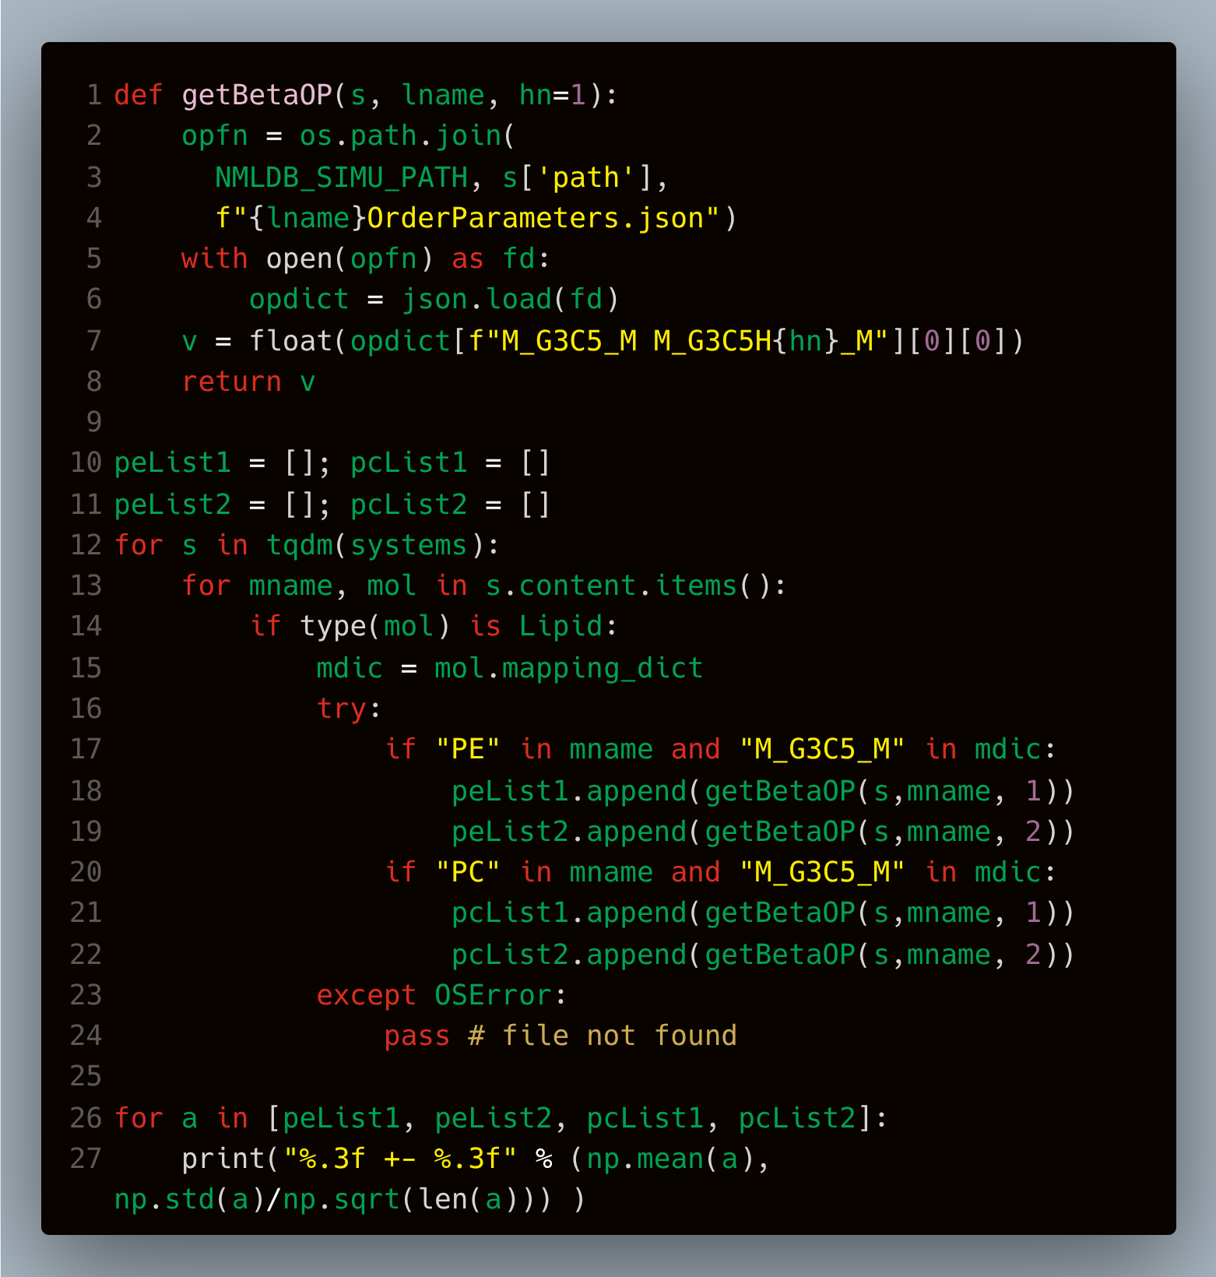
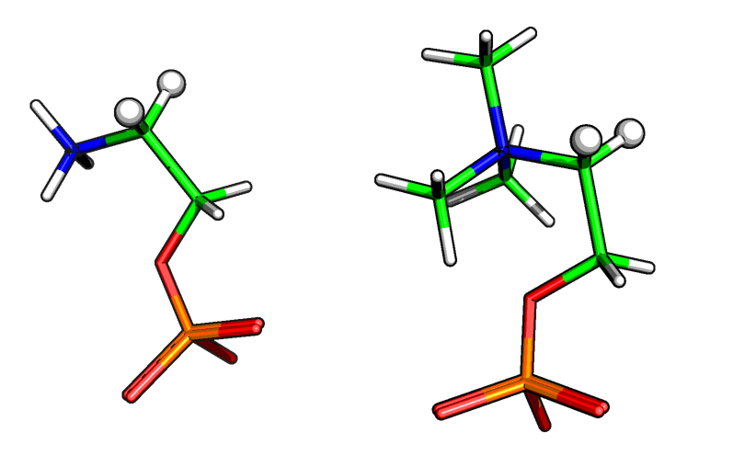
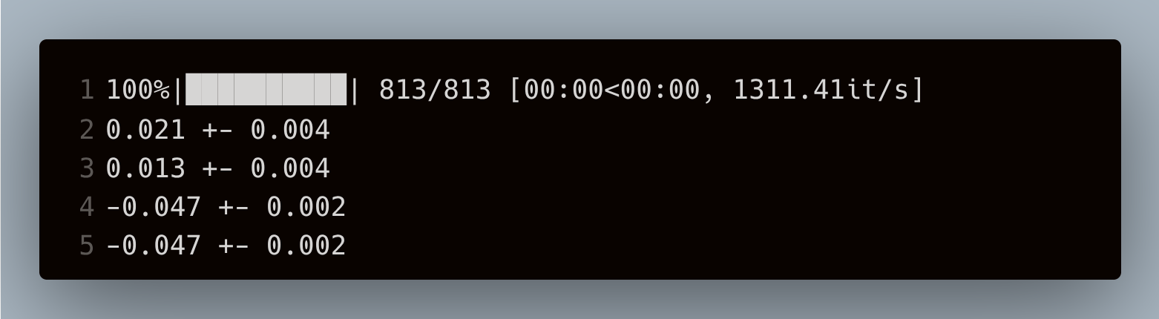
Example using DatabankLib library to perform a small research
PE
PC

Slide 20
Thank you for your attention!

